Slide 1


Slide 2



@EdCDCS
For all events, news, and support: cdcs.ed.ac.uk

Slide 3
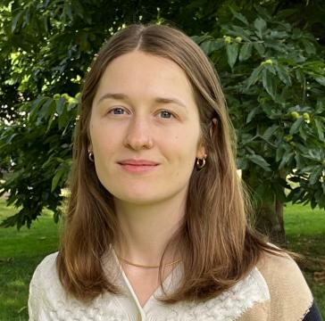
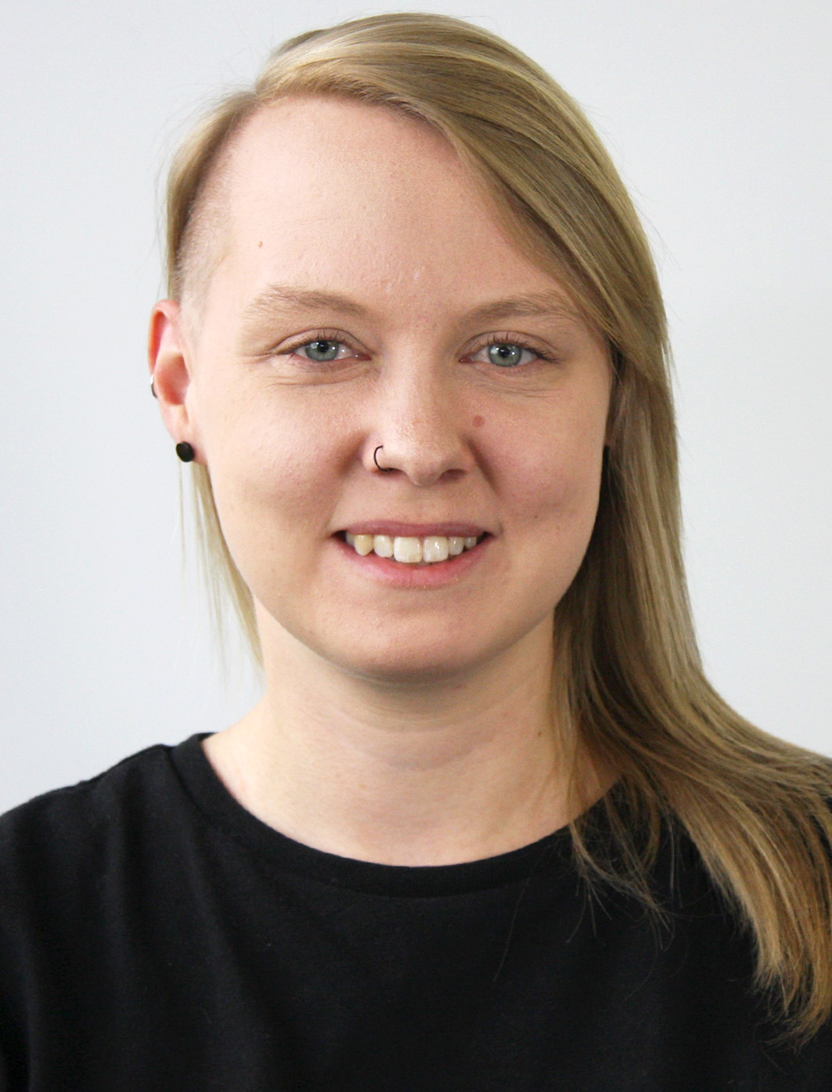
Welcome!
Sarah Schöttler
PhD student in data visualization & visualization developer
Aislinn Keogh
PhD student in Linguistics
Notes:
A/S

Slide 4
Week 1: Plan for Today
10:00 Welcome & Introduction
10:20 In groups: Review templates & plan your website
10:50 Break
11:00 Live demo: Adding your own content to your template
Troubleshooting
11:50 Wrap up & plans for next week
Find these slides online:
github.com/DCS-training/ website-with-github-pages
Notes:
S

Slide 5
Why have a personal website?
being in control of what people see when they look you up online
opportunity for personal branding
you can point people to other parts of your online presence: social media, portfolio, Google Scholar, etc.
having somewhere to point people to – a digital business card
portfolio
don’t include every possible thing, but focus on things that are relevant to how you want to present yourself
Notes:
S

Slide 6
Why GitHub Pages?
Free
Comparably easy to set up
Relatively nice URL: username.github.io
We will use vanilla HTML/CSS, but it support lots of web frameworks and static site generators via GitHub Actions
We are not using the built-in “Jekyll” static site generator; we are using HTML templates

Slide 7
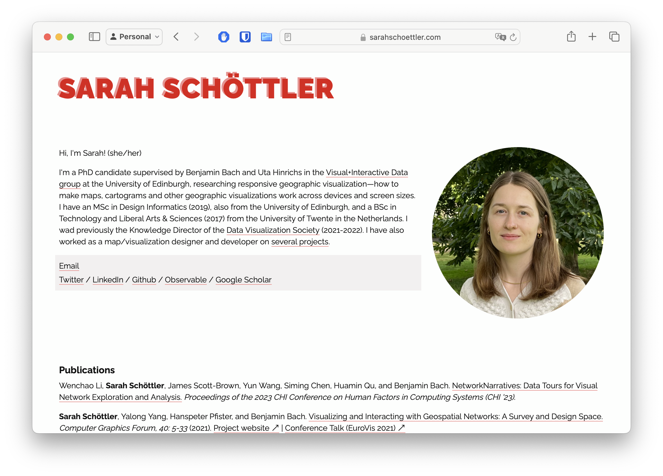
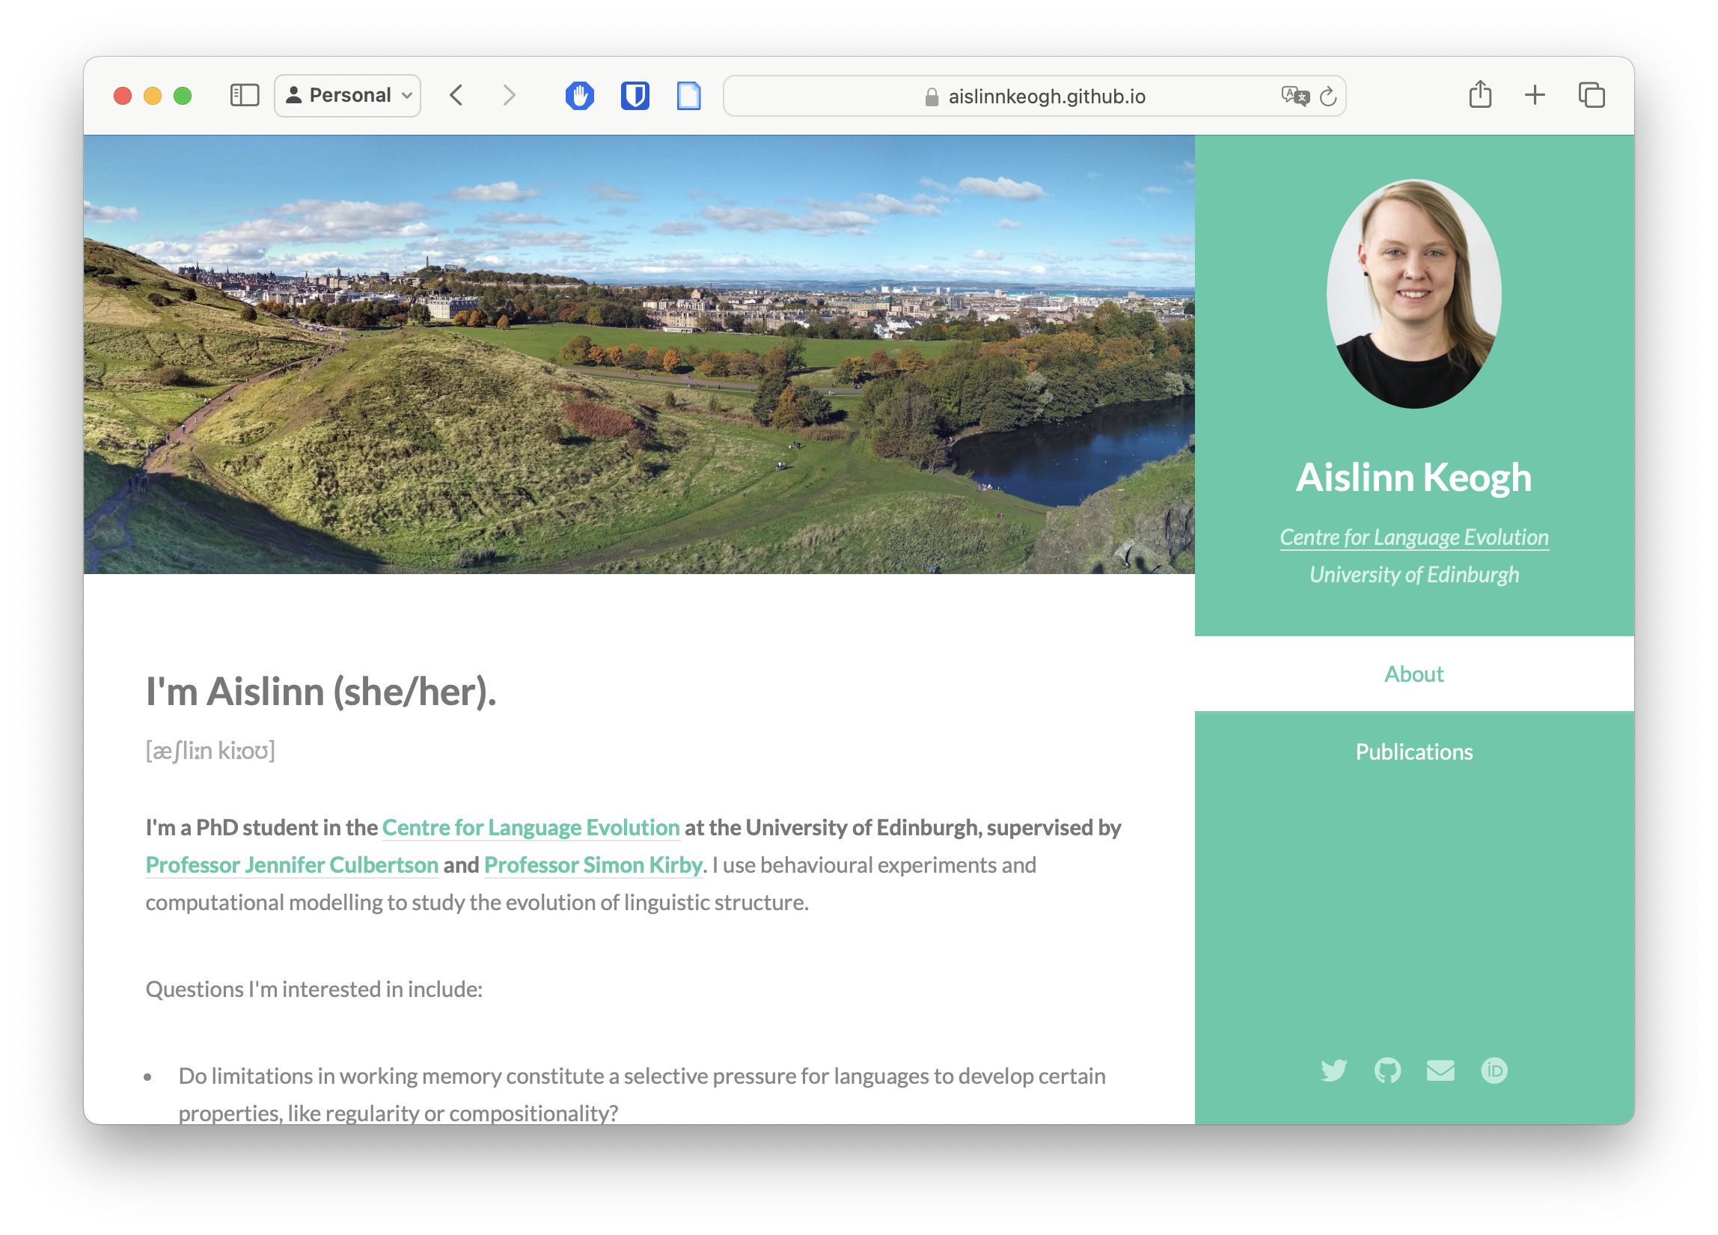
Examples: Our websites
https://sarahschoettler.com
https://aislinnkeogh.github.io
Notes:
S

Slide 8
Introductions What kind of website do you want to build?
Notes:
S

Slide 9
Live Demo https://html5up.net/
Notes:
A

Slide 10
Planning your website
Move into groups of 3-4
Discuss which templates you like
Share examples of websites you like
Choose a template from https://html5up.net/ – for beginners, we recommend:
Hyperspace
Solid State
Strata
Read Only (the one Aislinn is using!)
Think about what information you’d like to include, for example:
Photo
Bio / research interests
Links to social media profiles, Google Scholar, ORCID, etc.
News (e.g., conference attendance, new published papers)
Publications
Projects
Teaching/tutoring
Talks (possibly incl. slides, video recordings, etc.)
CV
Twenty
Prologue
Miniport
Arcana
Notes:
A
Bold sections are ”essential”, everything else is up to you

Slide 11
Break

Slide 12
Live Demo: Adding your own content to your template
https://developer.mozilla.org/en-US/docs/Learn/HTML/Cheatsheet
Notes:
A
Install VSCode or use a different text editor if you already have one
Open code for one of the templates and add some content – show after every code change how the website changes
Change title
Other header styles
Change body text
Italicized, bold
Add link
Link with text, with image – explain that basically anything can be a link
Replace/add image
Change menu (add/remove pages)

Slide 13
Plan for next week
Publishing your website online
Setting up a GitHub repo for your website
Setting up VSCode/GitHub integration
Publishing your website
Time to work on your website – we will be around to assist you

Slide 14
Welcome back!

Slide 15
Week 2: Plan for Today
10:00 Welcome
10:05 Live Demo: Setting up a GitHub repo for your website
Setting up VSCode/GitHub integration & publishing your website
Troubleshooting / Time to work on your website
10:50 Break
11:00 Troubleshooting / Time to work on your website
11:50 Wrap up & additional resources

Slide 16
Live Demo: Setting up a GitHub repo for your website
Notes:
S
sign up/log in on GitHub (point out that username will be part of the URL)
set up repo with the correct name: username.github.io

Slide 17
Live Demo: Setting up VSCode/GitHub integration
Notes:
S
Super easy – install the add-on, open a git repo in VS Code and a tab appears in the sidebar which you can use to commit whenever you save changes

Slide 18
Live Demo: Publishing your website
Notes:
S
go to Github repo settings + “publish from branch”

Slide 19
Thank you!
Feedback form: https://forms.office.com/r/YYNrqvuNr8
Link to these slides and text versions of the live demos: https://github.com/DCS-training/website-with-github-pages

